Slide 1

Where Should My Comic Store Go?
Alex Konkel
For
IBM Coursera Data Science Capstone

Slide 2
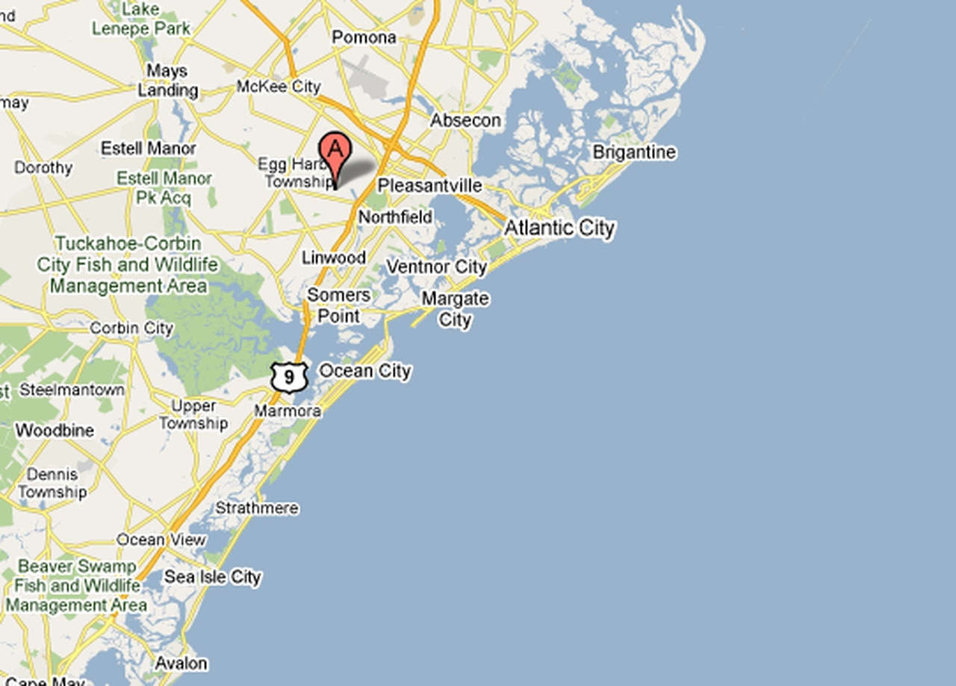
Is Egg Harbor (EHT) a good place for a new comic store?

Slide 3

The Plan
Find Similar Cities
Find Where Their Stores Are
Find Where Their Stores Aren’t
Find Similar Areas in EHT

Slide 4
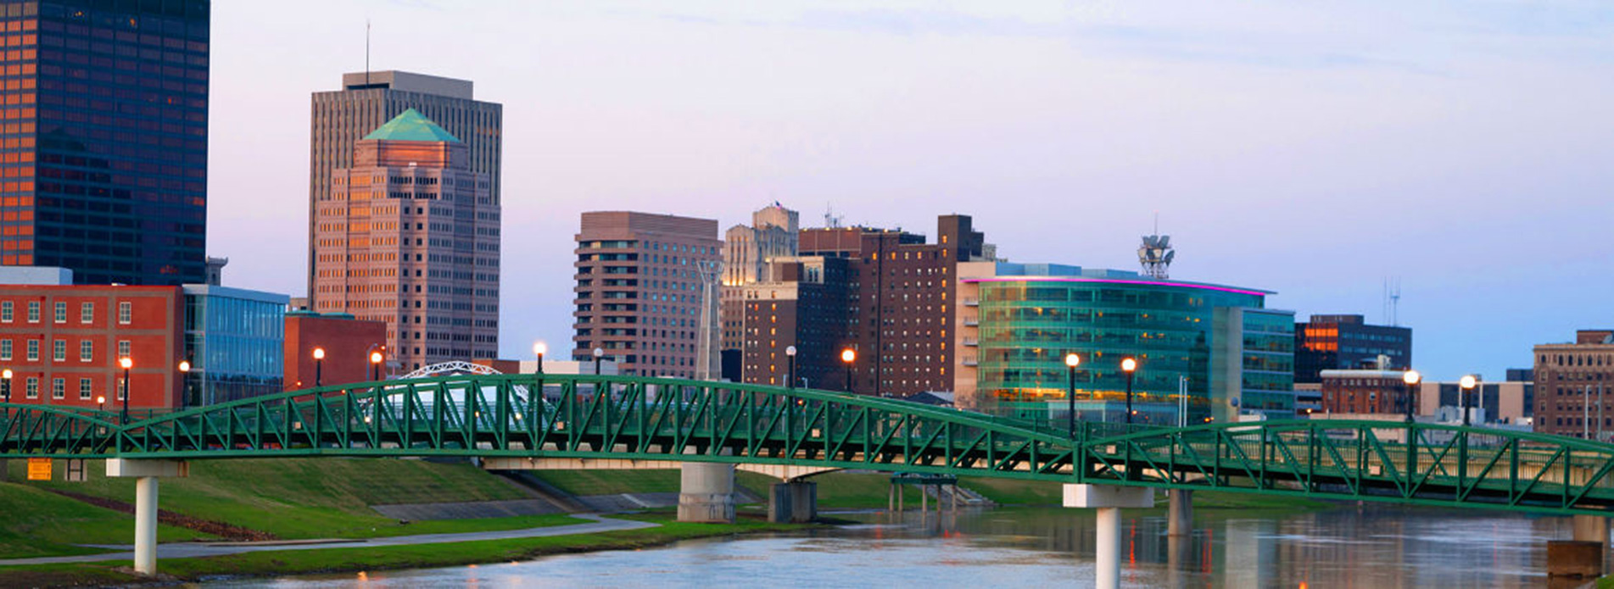
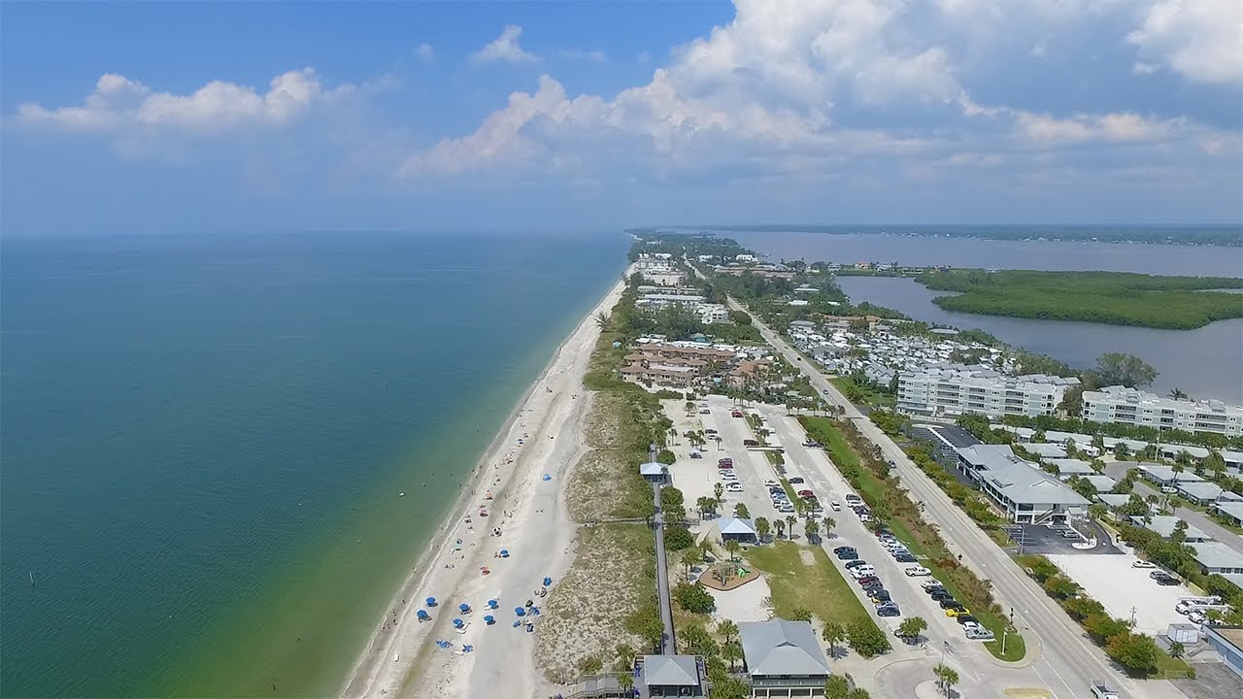
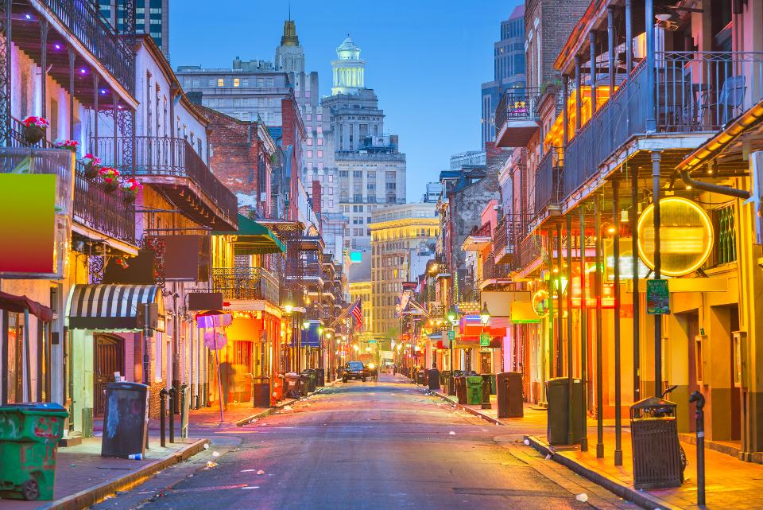

Comparison Cities
Las Vegas
New Orleans
Dayton, OH
Cleveland, OH
Albany, GA
North Port, FL
Port Arthur, TX

Slide 5
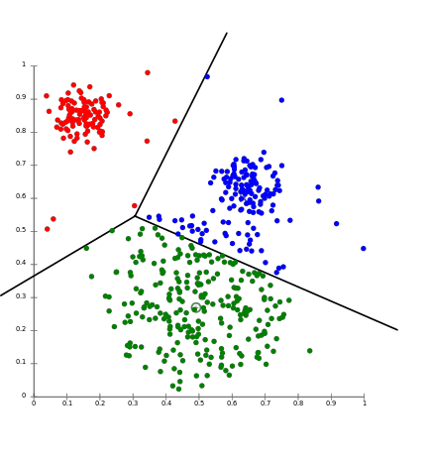
Clustering
Find comic stores in the comparison cities
Find what places are near the stores (Foursquare)
Find what places are in other locations around the city
Use the places to put stores/locations into groups (clustering!)
Use the groups to decide where comic stores are found

Slide 6
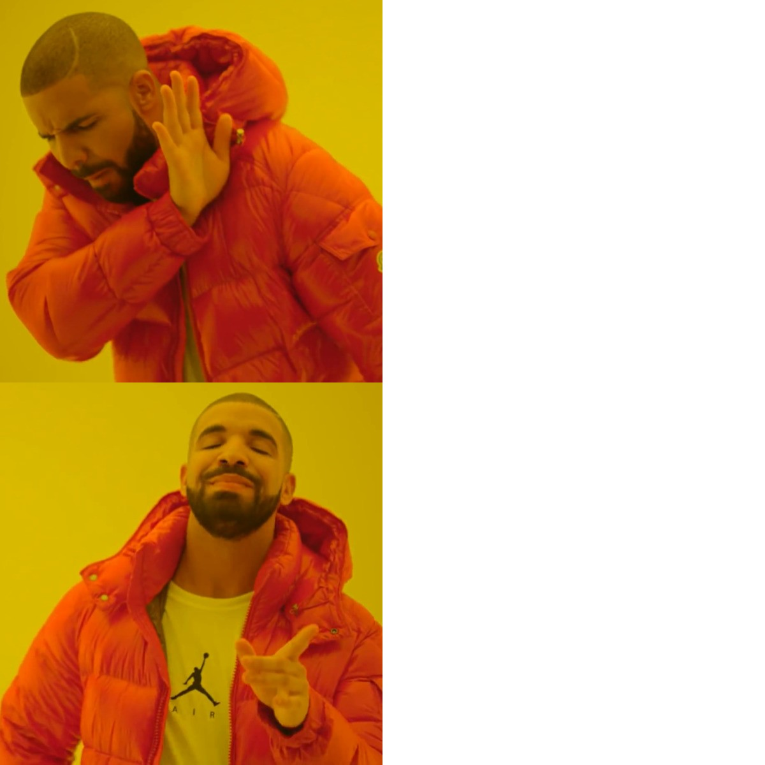
Clustering Results
Nature/open areas
Parks
Trails
Lakes
Farms
Business areas
Restaurants
Cafes
Shopping
Gyms

Slide 7
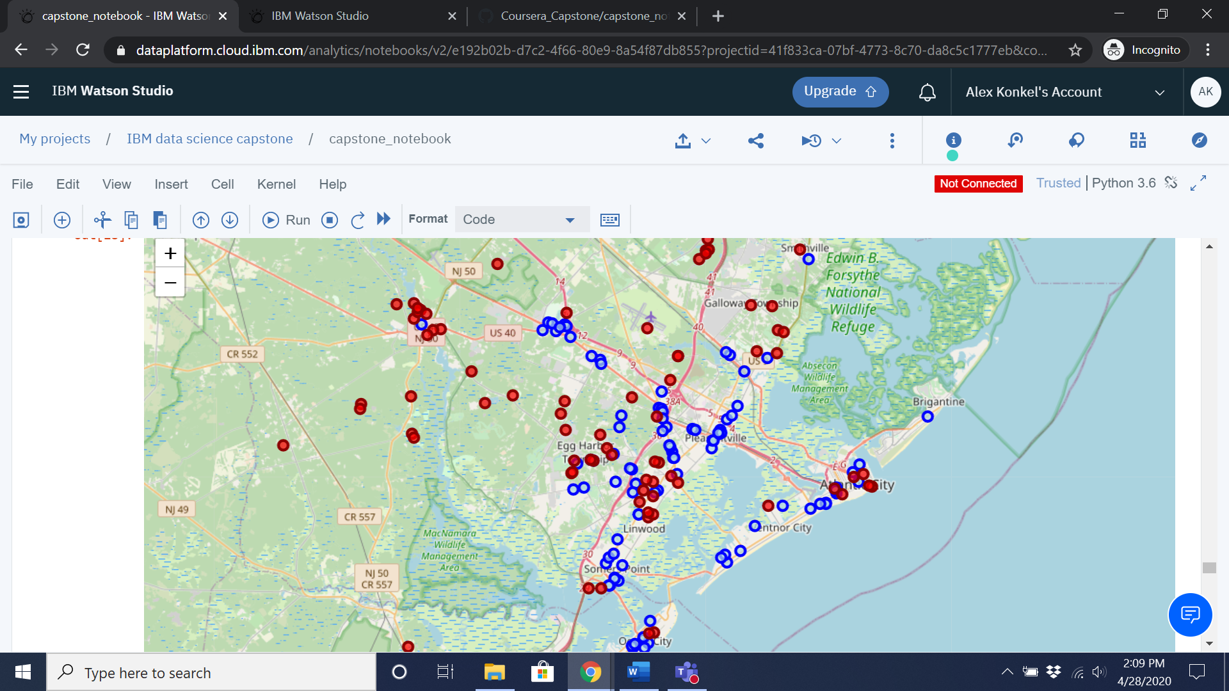
Possible Locations
Pleasantville (but low SES)
EHT (but already a store)
Atlantic City
Somers Point/Ocean City

Slide 8
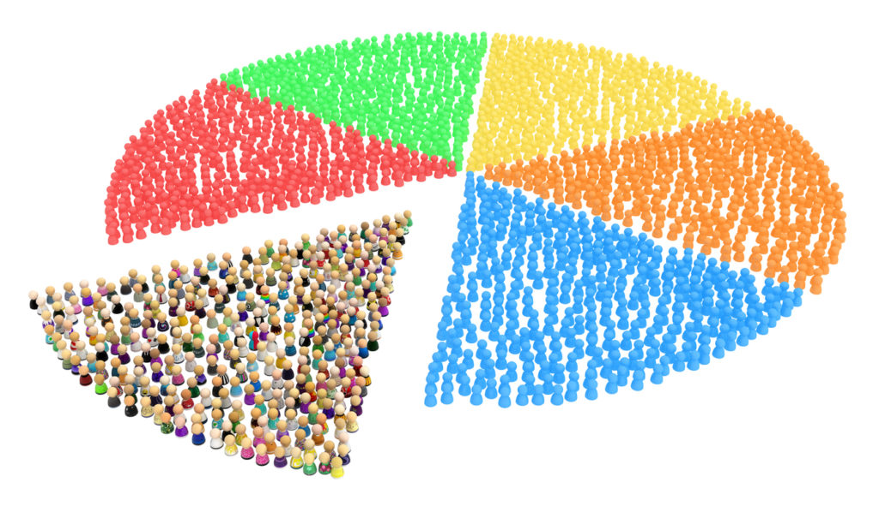
City Demographics
What characteristics do cities with more comic stores have?

Slide 9
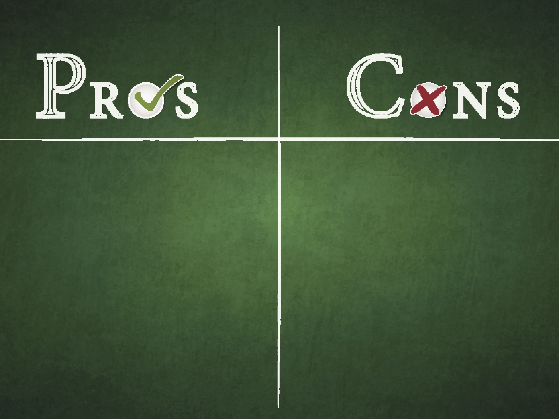
Egg Harbor Township
Good proportion working-age population
Good home value to income ratio
Low proportion workers in manufacturing
Small overall population
Already two stores in area
Not very walkable (low drop-in business)

Slide 10

Should I Open a Store?
EHT has some locations that might support a store based on local areas (clustering analysis), but the overall city characteristics (low population) and presence of two stores make the final decision questionable.

